Slide 1

What’s in my air? (AQI)
Project 2
Archana Rajagopalan
Chrison Mills
Nicole Nanton
Kolan
Felix Alvin

Slide 2

Why air quality?
From agriculture to industrial advances to overpopulation, earth has undergone many changes over the last 150 years that have had a huge impact on our air quality. For our 2nd project, we decided to analyze which cities were most affected by these factors and which cities were less affected. Based on the data we found, we were able to assess what factors contribute to air quality and air pollution.
Project 2

Slide 3

Our questions
1) Top 20 highest polluted cities and Top 20 lowest polluted cities from our data
2) What pollutants are contributing to poor air quality in highest polluted cities?
3) What industries, population, and occurrences do these cities have in common?
Project 2

Slide 4



Our Strategy and Code
Found list of cities from worldcities.csv.
We conducted of series of API pulls from WAQI to find data of 250 cities worldwide.
Pandas was used to clean and filter the data.
Data was loaded into MongoDB.
Showcase the graphical visualization of AQI with Geomapping and Plotly.
Deployed the code to github.io.
Created a webapp page using flask in the pythonanywhere.com.
Project 2

Slide 5
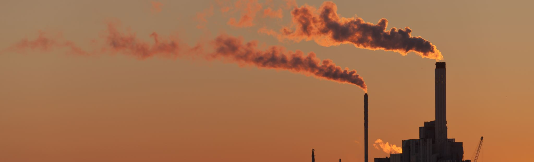
Pollutants looked for….
CO2 (Carbon Dioxide) – negative health effects in high concentration
NO2 (Nitrogen Dioxide) – is emitted when burning fuel
O3 (Ozone) – A form of Oxygen, blue gas that can damage the lungs
SO2 (Sulfur Dioxide) – Highly toxic gas (volcanic activity and disinfectant/bleach)
Also PM 10, PM 2.5

Slide 6



Our conclusions
Factors such as population, agriculture, manufacturing industries, environmental disasters, and natural occurrences were analyzed.
Fact 01
Fact 02
The top 5 highest cities were located in China. China is home to many manufacturing and industrial factories and is the hub for industries like automotive, biopharmaceutical, iron and steel, agricultural product processing, and mineral mining and quarrying industries. These industries are found to emit a wide range of pollutants in large quantities. The data also supports high population contributing to the air pollution problems in China.
The top 5 lowest cities were scattered all over the world. These countries were found, for the most part, to have industries that had an overall positive/less negative impact on the environment and had lower (not necessarily low) populations compared to cities with more toxic air. We concluded that many cities (like Stockholm, Sweden) made conscience efforts to cut down carbon dioxide emissions and fossils fuels by implementing wind and solar technology for their energy needs.
Project 2

Slide 7

Covid 19 impact
One positive fact
COVID 19 has been an overall negative situation as it continues to unfold causing US unemployment, countless casualties, and a state of panic and fear. However, by Americans and the world staying home our global air quality has improved overall, with US cities like NYC having a 30% drop in Nitrogen Dioxide (NO2) levels and China (most polluted country in the world) had a 40% drop in NO2 between December 20, 2019 to March 16, 2020. Though encouraging, scientists predict once lockdowns have been lifted, air quality will return to pre-COVID 19 levels.

Slide 8

That’s all folks!
Thank you for watching our presentation

